Slide 1

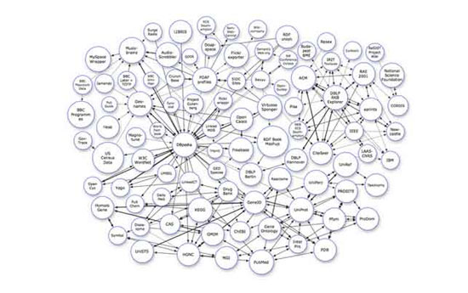
Welcome
to
Analysis and Design of Algorithms

Slide 2
Recursive Algorithms

Slide 3
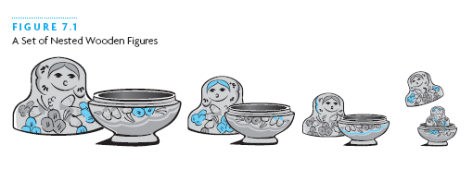
Recursive Thinking
Recursion is a problem-solving approach that can be used to generate simple solutions to certain kinds of problems that would be difficult to solve in other ways
Recursion splits a problem into one or more simpler versions of itself

Slide 4
Steps to Design a Recursive Algorithm
There must be at least one case (the base case), for a small value of n, that can be solved directly
A problem of a given size n can be split into one or more smaller versions of the same problem (recursive case)
Recognize the base case and provide a solution to it
Devise a strategy to split the problem into smaller versions of itself while making progress toward the base case
Combine the solutions of the smaller problems in such a way as to solve the larger problem

Slide 5
Proving that a Recursive Method is Correct
Proof by induction
  Prove the theorem is true for the base case
  Show that if the theorem is assumed true for n, then it must be true for n+1
Recursive proof is similar to induction
  Verify the base case is recognized and solved correctly
  Verify that each recursive case makes progress towards the base case
  Verify that if all smaller problems are solved correctly, then the original problem is also solved correctly

Slide 6
The Design Methodology
Every recursive call either solves a part of the problem or it reduce the size of the problem.
When to use recursion?

Slide 7
The Design Methodology
Base case
  The statement that “solves” the problem.
  Every recursive algorithm must have a base case.
General case
  The rest of the algorithm
  Contains the logic needed to reduce the size of the problem.

Slide 8
▓ The Rules for Designing a Recursive Algo.
Determine the base case.
Determine the general case.
Combine the base case and general case into an algorithm.
  Procedure p-name(paras-list)
  {
  if (base case)
  return(result);
  else
  general case; //using general case to call recursivly，using return when needed
  }

Slide 9
The four rules
Do the base cases first
Recur only with a simpler case
Don't use global or reference variables
Don't look down

Slide 10
Do the base cases first
Every recursive function must have some things it can do without recursion
These are the simple, or base, cases
Test for these cases, and do them first
This is just writing ordinary, nonrecursive code

Slide 11
Recur only with a simpler case
If the problem isn't simple enough to be a base case, break it into two parts:
  A simpler problem of the same kind (for example, a smaller number, or a shorter list)
  Extra work not solved by the simpler problem
Combine the results of the recursion and the extra work into a complete solution
“Simpler” means “more like a base case”

Slide 12
It's OK to use locals variables and parameters passed by value
A function has its own copy of
  local variables
  parameters passed by value
Each level of a recursive function has its own copy of these variables and parameters
Changing them at one level does not change them at other levels
One level can't interfere with another level

Slide 13
It's bad to use global variables or parameters passed by reference
There is only one copy of a global variable
If a parameter is passed by reference, there is only one copy of it
If such a variable is changed by a recursive function, it's changed at all levels
The various levels interfere with one another
This can get very confusing
Don't let this happen to you!

Slide 14
Don't look down
When you write or debug a recursive function, think about this level only
Wherever there is a recursive call, assume that it works correctly
If you can get this level correct, you will automatically get all levels correct
You really can't understand more than one level at a time, so don't even try

Slide 15
Limitations of recursion
You should not use recursion if the answer to any of the following questions is no:
  Is the algorithm or data structure naturally suited to recursion?
  Is the recursive solution shorter and more understandable?
  Does the recursive solution run within acceptable time and space limits? If time and space is not an issue, then recursive version is much easier to understand and preferred.

Slide 16
Linear and tree recursion
The factorial function and the first version of counting zeros are said to be linear recursive functions. A function is linear recursive when no pending operation involves another recursive function call (to the same function). For example in fact, the pending operation is a multiplication.
The second count of zeros (countzeros2) requires another recursive function call along with the pending operation (addition). When a recursive function requires at least 1 (or more) recursive call to evaluate the pending function, then it is called tree recursive.

Slide 17
Pending Operations and Tail Recursion
The functions we just examined required us to perform an addition or multiplication after the recursive function returns a value. When a recursive function has operations that are performed after the recursive call returns, the function is said to have pending operations.

Slide 18
A recursive function with no pending operations after the recursive call completes is defined to be tail recursive. It is desirable to have tail-recursive functions, because
a) the amount of information that gets stored during computation is independent of the number of recursive calls, and
b) some compilers can produce optimized code that replaces tail recursion by iteration (saving the overhead of the recursive calls)

Slide 19
From these definitions, it is clear that tree recursive functions can’t be tail recursive (but in almost all cases, a linear-recursive version can be written – see exercises)
It is possible to rewrite a non-tail-recursive function as tail recursive We will need to keep track of intermediate results, instead of letting the recursive call mechanism do that for us.

Slide 20
Converting Recursion to Tail-recursion
The general idea is to use an auxiliary parameter to hold intermediate results, and to incorporate the pending operation by suitably manipulating the auxiliary parameter. It is usually convenient to introduce an auxiliary function - the reason for this is to keep the user interface simpler – the user of the function doesn’t need to provide an auxiliary parameter.
For Factorial(x), the pending operation is to multiply the value of factorial(x-1) by x; This suggests initializing the pending value to 1, and multiplying this by the parameter x.
When we do so, we get this version of x!

Slide 21
A tail-recursive Factorial Function
We will use indirect recursion and an auxiliary function to rewrite factorial as tail-recursive: int factAux (int x, int result) {
if (x==0) return result;
return factAux(x-1, result * x);
}
int tailRecursiveFact( int x) {
return factAux (n, 1);
}
Notes:
Trace the calls to fact-aux for factorial(4)
Fact_aux(4,1)
-> fact_aux(3, 4)
-> fact_aux(2, 12)
-> fact_aux(1, 24)
-> fact_aux(0, 24)
– also note that we have 1 more call than is needed (could replace base case with x==1; but this is to make the definition completely symmetric with the recursive definition.

Slide 22
It’s important to see that we have removed the pending operation by using an intermediate variable, the parameter result, to keep track of the partial computation of x! – this results in a tail-recursive function

Slide 23
Equivalence of recursion, while loops
We can rewrite any recursive function as an iterative function (using a for- or while loop). An iterative factorial function is
int iterativeFact( int x) {
int result = 1;
for (int i = 1; i <= x; ++i)
result *= I;
return result;
}
how can we get from the recursive function to the iterative one?

Slide 24
Tail Recursion to Iterative functions
A tail recursive function has this form
F(x) {
if (baseProperty)
return G(x) // work done in base case
return F(H(x));
//H(x) is the work done in the recursive case

Slide 25
We can mechanically derive an iterative version:
F(x){
int temp = x;
while (! BaseProperty) {
temp = x;
x = H(temp);
}
return G(x);
}

Slide 26
Example: Factorial (what else?)
Recall the tail recursive factorial:
fact(x,1) { //where x is argument, 1 is intermediate result
if (x==0) return result;
return fact(x-1, result*x)
}
Base is x==0
G(x) = nothing. Just return result
H(x) = result= result * x; x=x-1;

Slide 27
Example (continued)
Substituting the parts into the iterative skeleton, we get:
{result = 1;
temp = x;
while (!(x==0)){ //G(x) is empty. Just return result
temp = x;
result = result * temp; //H(x) is
x = x – 1;
}

Slide 28
Complex Numbers
Remember how to multiply 2 complex numbers?
(a+bi)(c+di) = [ac –bd] + [ad + bc] i
Input: a,b,c,d Output: ac-bd, ad+bc
If a real multiplication costs $1 and an addition cost a penny, what is the cheapest way to obtain the output from the input?
Can you do better than $4.02?

Slide 29

Gauss’ Method:
Input: a,b,c,d Output: ac-bd, ad+bc
m₁ = ac
m₂ = bd
A₁ = m₁ – m₂ = ac-bd
m₃ = (a+b)(c+d) = ac + ad + bc + bd
A₂ = m₃ – m₁ – m₂ = ad+bc
Johann Carl Friedrich Gauss
(* 30. April 1777 in Braunschweig,
† 23. Februar 1855 in Göttingen)
Total Cost?
$3.05!

Slide 30
Question
The Gauss method saves one multiplication out of four. It requires 25% less work.
Could there be a context where performing 3 multiplications for every 4 provides a more dramatic savings?
Let’s back up a bit.

Slide 31
How to add 2 n-bit numbers.
*
*
*
*
*
*
*
*
*
*
*
*
*
*
*
*
*
*
*
*
*
*
+

Slide 32
How to add 2 n-bit numbers.
*
*
*
*
*
*
*
*
*
*
*
*
*
*
*
*
*
*
*
*
*
*
*
*
+

Slide 33
How to add 2 n-bit numbers.
*
*
*
*
*
*
*
*
*
*
*
*
*
*
*
*
*
*
*
*
*
*
*
*
*
*
+

Slide 34
How to add 2 n-bit numbers.
*
*
*
*
*
*
*
*
*
*
*
*
*
*
*
*
*
*
*
*
*
*
*
*
*
*
*
*
+

Slide 35
How to add 2 n-bit numbers.
*
*
*
*
*
*
*
*
*
*
*
*
*
*
*
*
*
*
*
*
*
*
*
*
*
*
*
*
*
*
+

Slide 36
How to add 2 n-bit numbers.
*
*
*
*
*
*
*
*
*
*
*
*
*
*
*
*
*
*
*
*
*
*
*
*
*
*
*
*
*
*
*
*
*
*
*
*
*
*
*
*
*
*
*
*
*
+

Slide 37
Time complexity of grade school addition
*
*
*
*
*
*
*
*
*
*
*
*
*
*
*
*
*
*
*
*
*
*
*
*
*
*
*
*
*
*
*
*
*
*
*
*
*
*
*
*
*
*
*
*
*
On any reasonable computer adding 3 bits can be done in constant time.
+

Slide 38
Is there a faster way to add?
QUESTION: Is there an algorithm to add two n-bit numbers whose time grows sub-linearly in n?

Slide 39
Any algorithm for addition must read all of the input bits
  Suppose there is a mystery algorithm that does not examine each bit
  Give the algorithm a pair of numbers. There must be some unexamined bit position i in one of the numbers
  If the algorithm returns the wrong answer, we have found a bug
  If the algorithm is correct, flip the bit at position i and give the algorithm this new input.
  The algorithm must return the same answer, which now is wrong.

Slide 40
So any algorithm for addition must use time at least linear in the size of the numbers.
Grade school addition is essentially as good as it can be.

Slide 41
How to multiply 2 n-bit numbers.
X
* * * * * * * *
* * * * * * * *
* * * * * * * *
* * * * * * * *
* * * * * * * *
n²
* * * * * * * *
* * * * * * * *
* * * * * * * *
* * * * * * * *
* * * * * * * *
* * * * * * * * * * * * * * * *

Slide 42
I get it! The total time is bounded by cn².

Slide 43
How to multiply 2 n-bit numbers:
Kindergarten Algorithm
a × b = a + a + a + ... + a
b
T(n) = θ(bn)
Fast?
Remember, we always pick the WORST CASE input for the input size n.
Thus, T(n) = cn2^{n}

Slide 44
Grade School Addition: Linear time
Grade School Multiplication: Quadratic time
Kindergarten Multiplication: Exponential time
time
# of bits in numbers

Slide 45
Neat! We have demonstrated that multiplication is a harder problem than addition.
Mathematical confirmation of our common sense.

Slide 46
Don’t jump to conclusions!
We have argued that grade school multiplication uses more time than grade school addition. This is a comparison of the complexity of two algorithms.
To argue that multiplication is an inherently harder problem than addition we would have to show that no possible multiplication algorithm runs in linear time.

Slide 47
Grade School Addition: θ(n) time
Grade School Multiplication: θ(n²) time
Is there a clever algorithm to multiply two numbers in linear time?

Slide 48
Despite years of research, no one knows!

Slide 49
Is there a faster way to multiply two numbers than the way you learned in grade school?

Slide 50
Good question!

Slide 51
Recursive Divide And Conquer
DIVIDE a problem into smaller subproblems
CONQUER them recursively
GLUE the answers together so as to obtain the answer to the larger problem

Slide 52
Multiplication of 2 n-bit numbers
X =
Y =
X = a 2^{n/2} + b Y = c 2^{n/2} + d
XY = ac 2^{n} + (ad+bc) 2^{n/2} + bd
a
b
c
d

Slide 53
Multiplication of 2 n-bit numbers
X =
Y =
XY = ac 2^{n} + (ad+bc) 2^{n/2} + bd
a
b
c
d
MULT(X,Y):
If |X| = |Y| = 1 then RETURN XY
Break X into a;b and Y into c;d
RETURN
MULT(a,c) 2^{n} + (MULT(a,d) + MULT(b,c)) 2^{n/2} + MULT(b,d)

Slide 54
Time required by MULT
T(n) = time taken by MULT on two n-bit numbers
What is T(n)?

Slide 55
Recurrence Relation
T(1) = k for some constant k
T(n) = 4 T(n/2) + k’ n + k’’ for some constants k’ and k’’
MULT(X,Y):
If |X| = |Y| = 1 then RETURN XY
Break X into a;b and Y into c;d
RETURN
MULT(a,c) 2^{n} + (MULT(a,d) + MULT(b,c)) 2^{n/2} + MULT(b,d)

Slide 56
For example
T(1) = 1
T(n) = 4 T(n/2) + n
How do we unravel T(n) so that we can determine its growth rate?

Slide 57
Technique 1: (Substitution)
Recurrence:
Guess:
Proof:

Slide 58
Technique 2: Recursion Tree
T(1) = 1
T(1)
=
1
T(n) = n + 4 T(n/2)
T(n)
n
=
n
=
(n/2)
T(n/2)
T(n/2)
T(n/2)
T(n/2)

Slide 59
T(n)
=
n
T(n/2)
T(n/2)
T(n/2)
T(n/2)

Slide 60
T(n)
=
n
n/2
T(n/2)
T(n/2)
T(n/2)
T(n/4)
T(n/4)
T(n/4)
T(n/4)

Slide 61
T(n)
=
n
n/2
n/2
n/2
n/2
T(n/4)
T(n/4)
T(n/4)
T(n/4)
T(n/4)
T(n/4)
T(n/4)
T(n/4)
T(n/4)
T(n/4)
T(n/4)
T(n/4)
T(n/4)
T(n/4)
T(n/4)
T(n/4)

Slide 62
T(n)
=
n
n/2
n/2
n/2
n/2
n/4
n/4
n/4
n/4
n/4
n/4
n/4
n/4
n/4
n/4
n/4
n/4
n/4
n/4
n/4
n/4
11111111111111111111111111111111 . . . . . . 111111111111111111111111111111111

Slide 63
n
0
1
n/2 + n/2 + n/2 + n/2
2
n/4 + n/4 + n/4 + n/4 + n/4 + n/4 + n/4 + n/4 + n/4 + n/4 + n/4 + n/4 + n/4 + n/4 + n/4 + n/4
i
Level i is the sum of 4^{i} copies of n/2^{i}
. . . . . . . . . . . . . . . . . . . . . . . . . .
1+1+1+1+1+1+1+1+1+1+1+1+1+1+1+1+1+1+1+1+1+1+1+1+1+1+1+1+1+1+1+1+1+1+1+1+1+1+1+1+1+1+1+1

Slide 64
=1⋅n
= 4⋅n/2
= 16⋅n/4
= 4^{i} ⋅n/2^{i}
= 4^{logn}⋅n/2^{logn} =2^{2logn}⋅1=n²

Slide 65
=1⋅n
= 4⋅n/2
= 16⋅n/4
= 4^{i} ⋅n/2^{i}
= 4^{logn}⋅n/2^{logn} =2^{2logn}⋅1=n²

Slide 66
Divide and Conquer MULT: θ(n²) time
Grade School Multiplication: θ(n²) time
All that work for nothing!

Slide 67
MULT revisited
MULT(X,Y):
If |X| = |Y| = 1 then RETURN XY
Break X into a;b and Y into c;d
RETURN
MULT(a,c) 2^{n} + (MULT(a,d) + MULT(b,c)) 2^{n/2} + MULT(b,d)
MULT calls itself 4 times. Can you see a way to reduce the number of calls?

Slide 68
Gauss’ Idea: Input: a,b,c,d Output: ac, ad+bc, bd
A₁ = ac
A₃ = bd
m₃ = (a+b)(c+d) = ac + ad + bc + bd
A₂ = m₃ – A₁- A₃ = ad + bc

Slide 69
Gaussified MULT (Karatsuba 1962)
MULT(X,Y):
If |X| = |Y| = 1 then RETURN XY
Break X into a;b and Y into c;d
e = MULT(a,c) and f =MULT(b,d)
RETURN e2^{n} + (MULT(a+b, c+d) – e - f) 2^{n/2} + f
T(n) ≈ 3 T(n/2) + kn
What is k?
e.g., k=8
(More precisely: T(n) = 2 T(n/2) + T(n/2 + 1) + kn)

Slide 70
T(n)
=
n
n/2
n/2
n/2
n/2
T(n/4)
T(n/4)
T(n/4)
T(n/4)
T(n/4)
T(n/4)
T(n/4)
T(n/4)
T(n/4)
T(n/4)
T(n/4)
T(n/4)
T(n/4)
T(n/4)
T(n/4)
T(n/4)

Slide 71
T(n)
=
n
T(n/2)
T(n/2)
T(n/2)

Slide 72
T(n)
=
n
n/2
T(n/2)
T(n/2)
T(n/4)
T(n/4)
T(n/4)

Slide 73
T(n)
=
n
n/2
n/2
n/2
T(n/4)
T(n/4)
T(n/4)
T(n/4)
T(n/4)
T(n/4)
T(n/4)
T(n/4)
T(n/4)

Slide 74
n
0
1
n/2 + n/2 + n/2
2
n/4 + n/4 + n/4 + n/4 + n/4 + n/4 + n/4 + n/4 + n/4
i
Level i is the sum of 3^{i} copies of n/2^{i}
. . . . . . . . . . . . . . . . . . . . . . . . . .
1+1+1+1+1+1+1+1+1+1+1+1+1+1+1+1+1+1+1+1+1+1+1+1+1+1+1+1+1+1+1+1+1+1+1+1+1+1+1+1+1+1+1

Slide 75
=1⋅n
= 3⋅n/2
= 9⋅n/4
= 3^{i} ⋅n/2^{i}
= 3^{logn}⋅n/2^{logn} =n^{log3}⋅1

Slide 76
Grade-School Multiplication
X
* * * * * * * *
* * * * * * * *
* * * * * * * *
* * * * * * * *
* * * * * * * *
n²
* * * * * * * *
* * * * * * * *
* * * * * * * *
* * * * * * * *
* * * * * * * *
* * * * * * * * * * * * * * * *

Slide 77
Dramatic improvement for large n
Not just a 25% savings!
θ(2n²) vs θ(8n^{1.58..})
Example:
A networking simulation requires 10 million multiplications of 16-bit integers.
Suppose that each bit operation takes 4 picosec on your machine (realistic).
Grade School Multiplication Time = 2 days 9 hours (do it over the weekend!)
Karatsuba Multiplication Time = 5.4 minutes (just enough time to grab a coffee!)

Slide 78
Multiplication Algorithms
Kindergarten | n2^{n}
Grade School | n²
Karatsuba | n^{1.58…}
Fastest Known (Schönhage-Strassen algorithm, 1971) | n logn loglogn

Slide 79
Methods for Solving Recurrences
Iteration method
Substitution method
Recursion tree method
Master method

Slide 80
The Iteration Method
Convert the recurrence into a summation and try to bound it using known series
  Iterate the recurrence until the initial condition is reached.
  Use back-substitution to express the recurrence in terms of n and the initial (boundary) condition.

Slide 81
The Iteration Method
T(n) = c + T(n/2)
T(n) = c + T(n/2)
= c + c + T(n/4)
= c + c + c + T(n/8)
Assume n = 2^{k}
T(n) = c + c + … + c + T(1)
= clgn + T(1)
= Θ(lgn)
T(n/2) = c + T(n/4)
T(n/4) = c + T(n/8)
k times

Slide 82
Iteration Method – Example
T(n) = n + 2T(n/2)
T(n) = n + 2T(n/2)
= n + 2(n/2 + 2T(n/4))
= n + n + 4T(n/4)
= n + n + 4(n/4 + 2T(n/8))
= n + n + n + 8T(n/8)
… = in + 2^{i}T(n/2^{i})
= kn + 2^{k}T(1)
= nlgn + nT(1) = Θ(nlgn)
Assume: n = 2^{k}
T(n/2) = n/2 + 2T(n/4)

Slide 83
The substitution method
Guess a solution
Use induction to prove that the solution works

Slide 84
Substitution method
Guess a solution
  T(n) = O(g(n))
  Induction goal: apply the definition of the asymptotic notation
    T(n) ≤ d g(n), for some d > 0 and n ≥ n₀
  Induction hypothesis: T(k) ≤ d g(k) for all k < n
Prove the induction goal
  Use the induction hypothesis to find some values of the constants d and n₀ for which the induction goal holds
(strong induction)

Slide 85
Example: Binary Search
T(n) = c + T(n/2)
Guess: T(n) = O(lgn)
  Induction goal: T(n) ≤ d lgn, for some d and n ≥ n₀
  Induction hypothesis: T(n/2) ≤ d lg(n/2)
Proof of induction goal:
T(n) = T(n/2) + c ≤ d lg(n/2) + c
= d lgn – d + c ≤ d lgn
if: – d + c ≤ 0, d ≥ c
Base case?

Slide 86
Example 2
T(n) = T(n-1) + n
Guess: T(n) = O(n²)
  Induction goal: T(n) ≤ c n², for some c and n ≥ n₀
  Induction hypothesis: T(n-1) ≤ c(n-1)² for all k < n
Proof of induction goal:
T(n) = T(n-1) + n ≤ c (n-1)² + n
= cn² – (2cn – c - n) ≤ cn²
if: 2cn – c – n ≥ 0 ⇔ c ≥ n/(2n-1) ⇔ c ≥ 1/(2 – 1/n)
  For n ≥ 1 ⇒ 2 – 1/n ≥ 1 ⇒ any c ≥ 1 will work

Slide 87
Example 3
T(n) = 2T(n/2) + n
Guess: T(n) = O(nlgn)
  Induction goal: T(n) ≤ cn lgn, for some c and n ≥ n₀
  Induction hypothesis: T(n/2) ≤ cn/2 lg(n/2)
Proof of induction goal:
T(n) = 2T(n/2) + n ≤ 2c (n/2)lg(n/2) + n
= cn lgn – cn + n ≤ cn lgn
if: - cn + n ≤ 0 ⇒ c ≥ 1
Base case?

Slide 88
Changing variables
T(n) = 2T( ) + lgn
  Rename: m = lgn ⇒ n = 2^{m}
  T (2^{m}) = 2T(2^{m/2}) + m
  Rename: S(m) = T(2^{m})
  S(m) = 2S(m/2) + m ⇒ S(m) = O(mlgm) (demonstrated before)
  T(n) = T(2^{m}) = S(m) = O(mlgm)=O(lgnlglgn)
  Idea: transform the recurrence to one that you have seen before

Slide 89
Substitution
Recurrence:
Guess:
Proof:

Slide 90
More Generally, and Formally

Slide 91
To Summarize

Slide 92
Base Case

Slide 93
Guess Form and Calculate Coefficients
Recurrence Relation:
T(1) = 1 & T(n) = 4T(n/2) + n
Guess: T(n) = an² + bn + c
Verify:
Left Hand Side | Right Hand Side
T(1) = a+b+c T(n) = an² +bn+c | 1 4T(n/2) + n = 4 [a (^{n}/₂)² + b (^{n}/₂) +c] + n = an² +(2b+1)n + 4c

Slide 94
Guess Form and Calculate Coefficients
Recurrence Relation:
T(1) = 1 & T(n) = 4T(n/2) + n
Guess: T(n) = an² + bn + c
Verify:
Left Hand Side | Right Hand Side
T(1) = a+b+c T(n) = an² +bn+c | 1 4T(n/2) + n = 4 [a (^{n}/₂)² + b (^{n}/₂) +c] + n = an² +(2b+1)n + 4c
c=4c
→ c=0

Slide 95
Guess Form and Calculate Coefficients
Recurrence Relation:
T(1) = 1 & T(n) = 4T(n/2) + n
Guess: T(n) = an² +bn + 0
Verify:
Left Hand Side | Right Hand Side
T(1) = a+b+c T(n) = an² +bn+c | 1 4T(n/2) + n = 4 [a (^{n}/₂)² + b (^{n}/₂) +c] + n = an² +(2b+1)n + 4c
b = 2b+1
→ b = -1

Slide 96
Guess Form and Calculate Coefficients
Recurrence Relation:
T(1) = 1 & T(n) = 4T(n/2) + n
Guess: T(n) = an² - 1n + 0
Verify:
Left Hand Side | Right Hand Side
T(1) = a+b+c T(n) = an² +bn+c | 1 4T(n/2) + n = 4 [a (^{n}/₂)² + b (^{n}/₂) +c] + n = an² +(2b+1)n + 4c
a=a

Slide 97
Guess Form and Calculate Coefficients
Recurrence Relation:
T(1) = 1 & T(n) = 4T(n/2) + n
Guess: T(n) = an² - 1n + 0
Verify:
Left Hand Side | Right Hand Side
T(1) = a+b+c T(n) = an² +bn+c | 1 4T(n/2) + n = 4 [a (^{n}/₂)² + b (^{n}/₂) +c] + n = an² +(2b+1)n + 4c
a+b+c=1
a-1+0=1
→a=2

Slide 98
Approximate Form and Calculate Exponent
Recurrence Relation:
T(1) = 1 & T(n) = aT(n/b) + f(n)
which is bigger?
Guess

Slide 99
Calculate Exponent
Recurrence Relation:
T(1) = 1 & T(n) = aT(n/b) + f(n)
Guess: aT(n/b) << f(n)
Simplify: T(n) ≈ f(n)
In this case, the answer is easy. T(n) = Θ(f(n))

Slide 100
Calculate Exponent
Recurrence Relation:
T(1) = 1 & T(n) = aT(n/b) + f(n)
Guess: aT(n/b) >> f(n)
Simplify: T(n) ≈ aT(n/b)
In this case, the answer is harder.

Slide 101
Calculate Exponent
Recurrence Relation:
T(1) = 1 & T(n) = aT(n/b)
Guess: T(n) = cn^{α}
Verify:
= cn
(^{log a}/_{log b})
Left Hand Side | Right Hand Side
T(n) = cn^{α} | aT(n/b) = a [c (^{n}/_{b}) ^{α} ] = c a b^{−α} n^{α}
1 = a b^{-α}
b^{α} = a
α log b = log a
α = ^{log a}/_{log b}

Slide 102
Calculate Exponent
Recurrence Relation:
T(1) = 1 & T(n) = 4T(n/2)
Guess: T(n) = cn^{α}
Verify:
= cn
(^{log a}/_{log b})
Left Hand Side | Right Hand Side
T(n) = cn^{α} | aT(n/b) = a [c (^{n}/_{b}) ^{α} ] = c a b^{−α} n^{α}
1 = a b^{-α}
b^{α} = a
α log b = log a
α = ^{log a}/_{log b}

Slide 103
Calculate Exponent
Recurrence Relation:
T(1) = 1 & T(n) = aT(n/b) + f(n)
If bigger then
If bigger then
(^{log a}/_{log b})
T(n) = Θ(n )
T(n) = Θ(f(n))
And if aT(n/b) ≈ f(n)
what is T(n) then?

Slide 104
The recursion-tree method
Convert the recurrence into a tree:
  Each node represents the cost incurred at various levels of recursion
  Sum up the costs of all levels
Used to “guess” a solution for the recurrence

Slide 105
Recurrence Relations
T(1) = 1
T(n) = a T(n/b) + f(n)

Slide 106
Technique 4: Recursion Tree Method
T(1) = 1
T(1)
=
1
T(n) = a T(n/b) + f(n)
T(n)
=
f(n)
a
T(n/b)
T(n/b)
T(n/b)
T(n/b)

Slide 107
T(n)
=
f(n)
a
f(n/b)
f(n/b)
f(n/b)
f(n/b)
a
a
a
a
T(n/b²)
T(n/b²)
T(n/ b²)
T(n/ b²)
T(n/b²)
T(n/b²)
T(n/ b²)
T(n/ b²)
T(n/b²)
T(n/b²)
T(n/ b²)
T(n/ b²)
T(n/b²)
T(n/b²)
T(n/ b²)
T(n/ b²)

Slide 108
T(n)
=
f(n)
a
f(n/b)
f(n/b)
f(n/b)
f(n/b)
a
a
a
a
T(n/b²)
T(n/b²)
T(n/ b²)
T(n/ b²)
T(n/b²)
T(n/b²)
T(n/ b²)
T(n/ b²)
T(n/b²)
T(n/b²)
T(n/ b²)
T(n/ b²)
T(n/b²)
T(n/b²)
T(n/ b²)
T(n/ b²)
11111111111111111111111111111111 . . . . . . 111111111111111111111111111111111

Slide 109
Evaluating: T(n) = aT(n/b)+f(n)
Level
0
1
2
i
h
# Instances

Slide 110
Evaluating: T(n) = aT(n/b)+f(n)
Level |  | Instance size
0
1
2
i
h
# Instances

Slide 111
Evaluating: T(n) = aT(n/b)+f(n)
Level |  | Instance size
0 |  | n
1
2
i
h
# Instances

Slide 112
Evaluating: T(n) = aT(n/b)+f(n)
Level |  | Instance size
0 |  | n
1 |  | n/b
2
i
h
# Instances

Slide 113
Evaluating: T(n) = aT(n/b)+f(n)
Level |  | Instance size
0 |  | n
1 |  | n/b
2 |  | n/b²
i
h
# Instances

Slide 114
Evaluating: T(n) = aT(n/b)+f(n)
Level |  | Instance size
0 |  | n
1 |  | n/b
2 |  | n/b²
i |  | n/b^{i}
h |  | n/b^{h}
# Instances

Slide 115
Evaluating: T(n) = aT(n/b)+f(n)
Level |  | Instance size
0 |  | n
1 |  | n/b
2 |  | n/b²
i |  | n/b^{i}
h |  | n/b^{h}
# Instances

Slide 116
Evaluating: T(n) = aT(n/b)+f(n)
Level |  | Instance size
0 |  | n
1 |  | n/b
2 |  | n/b²
i |  | n/b^{i}
h |  | n/b^{h} = 1
# Instances
base case

Slide 117
Evaluating: T(n) = aT(n/b)+f(n)
Level |  | Instance size
0 |  | n
1 |  | n/b
2 |  | n/b²
i |  | n/b^{i}
h |  | n/b^{h} = 1
# Instances

Slide 118
Evaluating: T(n) = aT(n/b)+f(n)
Level |  | Instance size
0 |  | n
1 |  | n/b
2 |  | n/b²
i |  | n/b^{i}
h = ^{log n}/_{log b} |  | n/b^{h} = 1
# Instances
b^{h} = n
h log b = log n
h = ^{log n}/_{log b}

Slide 119
Evaluating: T(n) = aT(n/b)+f(n)
Level |  | Instance size | Work in stack frame
0 |  | n
1 |  | n/b
2 |  | n/b²
i |  | n/b^{i}
h = ^{log n}/_{log b} |  | 1
# Instances

Slide 120
Evaluating: T(n) = aT(n/b)+f(n)
Level |  | Instance size | Work in stack frame
0 |  | n | f(n)
1 |  | n/b | f(n/b)
2 |  | n/b² | f(n/b²)
i |  | n/b^{i} | f(n/b^{i})
h = ^{log n}/_{log b} |  | 1 | T(1)
# Instances

Slide 121
Evaluating: T(n) = aT(n/b)+f(n)
Level |  | Instance size | Work in stack frame | # stack frames
0 |  | n | f(n)
1 |  | n/b | f(n/b)
2 |  | n/b² | f(n/b²)
i |  | n/b^{i} | f(n/b^{i})
h = ^{log n}/_{log b} |  | n/b^{h} | T(1)
# Instances

Slide 122
Evaluating: T(n) = aT(n/b)+f(n)
Level |  | Instance size | Work in stack frame | # stack frames
0 |  | n | f(n) | 1
1 |  | n/b | f(n/b) | a
2 |  | n/b² | f(n/b²) | a²
i |  | n/b^{i} | f(n/b^{i}) | a^{i}
h = ^{log n}/_{log b} |  | n/b^{h} | T(1) | a^{h}
# Instances

Slide 123
Evaluating: T(n) = aT(n/b)+f(n)
Level |  | Instance size | Work in stack frame | # stack frames
0 |  | n | f(n) | 1
1 |  | n/b | f(n/b) | a
2 |  | n/b² | f(n/b²) | a²
i |  | n/b^{i} | f(n/b^{i}) | a^{i}
h = ^{log n}/_{log b} |  | n/b^{h} | T(1) | a^{h}
# Instances

Slide 124
Evaluating: T(n) = aT(n/b)+f(n)
Level |  | Instance size | Work in stack frame | # stack frames
0 |  | n | f(n) | 1
1 |  | n/b | f(n/b) | a
2 |  | n/b² | f(n/b²) | a²
i |  | n/b^{i} | f(n/b^{i}) | a^{i}
h = ^{log n}/_{log b} |  | n/b^{h} | T(1) | a^{h}
# Instances

Slide 125
Evaluating: T(n) = aT(n/b)+f(n)
Level |  | Instance size | Work in stack frame | # stack frames | Work in Level
0 |  | n | f(n) | 1
1 |  | n/b | f(n/b) | a
2 |  | n/b² | f(n/b²) | a²
i |  | n/b^{i} | f(n/b^{i}) | a^{i}
h = ^{log n}/_{log b} |  | n/b^{h} | T(1)
# Instances
^{log a}/_{log b}
n

Slide 126
Evaluating: T(n) = aT(n/b)+f(n)
Level |  | Instance size | Work in stack frame | # stack frames | Work in Level
0 |  | n | f(n) | 1 | 1 · f(n)
1 |  | n/b | f(n/b) | a | a · f(n/b)
2 |  | n/b² | f(n/b²) | a² | a² · f(n/b²)
i |  | n/b^{i} | f(n/b^{i}) | a^{i} | a^{i} · f(n/b^{i})
h = ^{log n}/_{log b} |  | n/b^{h} | T(1)
# Instances
^{log a}/_{log b}
^{log a}/_{log b}
n
n · T(1)
Total Work T(n) = ∑_{i=0..h} a^{i}⋅f(n/b^{i})

Slide 127
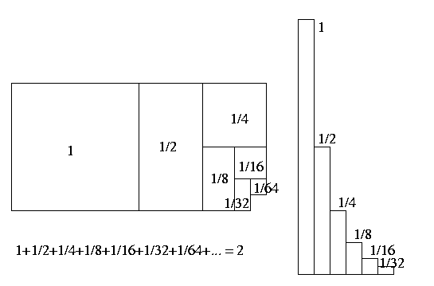
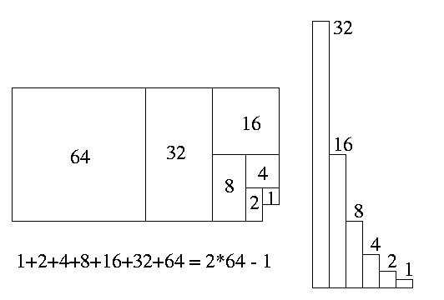
Evaluating: T(n) = aT(n/b)+f(n)
= ∑_{i=0..h} a^{i}⋅f(n/b^{i})
If a Geometric Sum
∑_{i=0..n} x^{i} = θ(max(first term, last term))

Slide 128
Evaluating: T(n) = aT(n/b)+f(n)
Level |  | Instance size | Work in stack frame | # stack frames | Work in Level
0 |  | n | f(n) | 1 | 1 · f(n)
1 |  | n/b | f(n/b) | a | a · f(n/b)
2 |  | n/b² | f(n/b²) | a² | a² · f(n/b²)
i |  | n/b^{i} | f(n/b^{i}) | a^{i} | a^{i} · f(n/b^{i})
h = ^{log n}/_{log b} |  | n/b^{h} | T(1)
^{log a}/_{log b}
^{log a}/_{log b}
n
n · T(1)
Dominated by Top Level or Base Cases

Slide 129
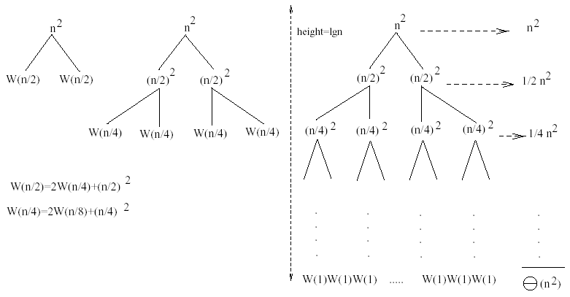
Example 1
W(n) = 2W(n/2) + n²
Subproblem size at level i is: n/2^{i}
Subproblem size hits 1 when 1 = n/2^{i} ⇒ i = lgn
Cost of the problem at level i = (n/2^{i})² No. of nodes at level i = 2^{i}
Total cost:
⇒ W(n) = O(n²)

Slide 130
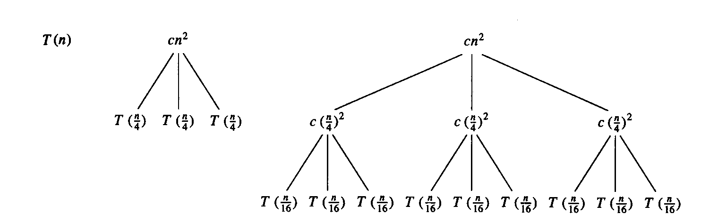
Example 2
E.g.: T(n) = 3T(n/4) + cn²
Subproblem size at level i is: n/4^{i}
Subproblem size hits 1 when 1 = n/4^{i} ⇒ i = log₄n
Cost of a node at level i = c(n/4^{i})²
Number of nodes at level i = 3^{i} ⇒ last level has 3^{log}₄^{n} = n^{log}₄³ nodes
Total cost:
⇒ T(n) = O(n²)

Slide 131
Example 2 - Substitution
T(n) = 3T(n/4) + cn²
Guess: T(n) = O(n²)
  Induction goal: T(n) ≤ dn², for some d and n ≥ n₀
  Induction hypothesis: T(n/4) ≤ d (n/4)²
Proof of induction goal:
T(n) = 3T(n/4) + cn²
≤ 3d (n/4)² + cn²
= (3/16) d n² + cn²
≤ d n² if: d ≥ (16/13)c
Therefore: T(n) = O(n²)

Slide 132
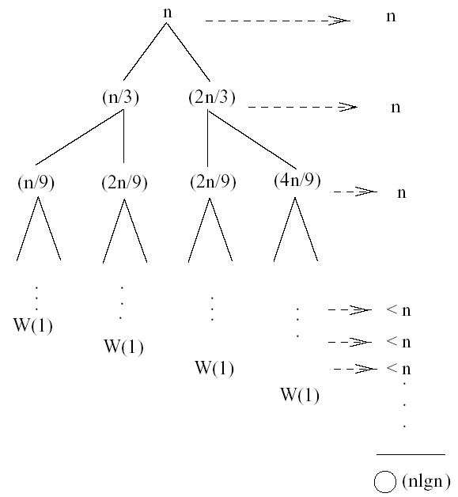
Example 3 (simpler proof)
W(n) = W(n/3) + W(2n/3) + n
The longest path from the root to a leaf is: n → (2/3)n → (2/3)² n → … → 1
Subproblem size hits 1 when 1 = (2/3)^{i}n ⇔ i=log_{3/2}n
Cost of the problem at level i = n
Total cost:

Slide 133
Example 3 - Substitution
W(n) = W(n/3) + W(2n/3) + O(n)
Guess: W(n) = O(nlgn)
  Induction goal: W(n) ≤ dnlgn, for some d and n ≥ n₀
  Induction hypothesis: W(k) ≤ d klgk for any K < n (n/3, 2n/3)
Proof of induction goal:
Try it out as an exercise!!
T(n) = O(nlgn)

Slide 134
Example of recursion tree
Solve T(n) = T(n/4) + T(n/2) + n²:
n²
(n/4)²
(n/2)²
(n/16)²
(n/8)²
(n/8)²
(n/4)²
…
…
Θ(1)
Total =
= Θ(n²)
geometric series

Slide 135
Master Theorem

Slide 136
Motivation: Asymptotic Behavior of Recursive Algorithms
When analyzing algorithms, recall that we only care about the asymptotic behavior
Recursive algorithms are no different
Rather than solving exactly the recurrence relation associated with the cost of an algorithm, it is sufficient to give an asymptotic characterization
The main tool for doing this is the master theorem

Slide 137
Outline
Motivation
The Master Theorem
  Pitfalls
  5+3 examples
4th Condition
  1 example

Slide 138
Master’s method
“Cookbook” for solving recurrences of the form:
where, a ≥ 1, b > 1, and f(n) > 0
Idea: compare f(n) with n^{log}_{b}ª
f(n) is asymptotically smaller or larger than n^{log}_{b}ª by a polynomial factor n^{ε}
f(n) is asymptotically equal with n^{log}_{b}ª

Slide 139
Idea of master theorem
Recursion tree:
f (n)
f (n)
a
f (n/b)
f (n/b)
…
f (n/b)
a f (n/b)
a
h = log_{b}n
f (n/b²)
f (n/b²)
…
f (n/b²)
a² f (n/b²)
…
…
#leaves = a^{h}
= a^{logbn}
= n^{logba}
n^{logba}Τ (1)
Τ (1)

Slide 140
Why n^{log}_{b}ª?
Case 1:
  If f(n) is dominated by n^{log}_{b}ª:
    T(n) = Θ(n^{log}_{b}^{n})
Case 3:
  If f(n) dominates n^{log}_{b}ª:
    T(n) = Θ(f(n))
Case 2:
  If f(n) = Θ(n^{log}_{b}ª):
    T(n) = Θ(n^{log}_{b}ª logn)
Assume n = b^{k} ⇒ k = log_{b}n
At the end of iteration i = k:

Slide 141
Three common cases
Compare f (n) with n^{logba}:
f (n) = O(n^{logba – ε}) for some constant ε > 0.
  f (n) grows polynomially slower than n^{logba} (by an n^{ε} factor).
Solution: T(n) = Θ(n^{logba}) .

Slide 142
Idea of master theorem
Recursion tree:
f (n)
f (n)
a
f (n/b)
f (n/b)
…
f (n/b)
a f (n/b)
a
h = log_{b}n
f (n/b²)
f (n/b²)
…
f (n/b²)
a² f (n/b²)
…
…
CASE 1: The weight increases geometrically from the root to the leaves. The leaves hold a constant fraction of the total weight.
n^{logba}Τ (1)
Τ (1)
Θ(n^{logba})

Slide 143
Three common cases
Compare f (n) with n^{logba}:
f (n) = Θ(n^{logba} lg^{k}n) for some constant k ≥ 0.
  f (n) and n^{logba} grow at similar rates.
  Solution: T(n) = Θ(n^{logba} lg^{k+1}n) .

Slide 144
Idea of master theorem
Recursion tree:
f (n)
f (n)
a
f (n/b)
f (n/b)
…
f (n/b)
a f (n/b)
a
h = log_{b}n
f (n/b²)
f (n/b²)
…
f (n/b²)
a² f (n/b²)
…
…
CASE 2: (k = 0) The weight is approximately the same on each of the log_{b}n levels.
n^{logba}Τ (1)
Τ (1)
Θ(n^{logba}lg n)

Slide 145
Three common cases (cont.)
Compare f (n) with n^{logba}:
f (n) = Ω(n^{logba + ε}) for some constant ε > 0.
  f (n) grows polynomially faster than n^{logba} (by an n^{ε} factor),
and f (n) satisfies the regularity condition that a f (n/b) ≤ c f (n) for some constant c < 1.
Solution: T(n) = Θ( f (n) ) .

Slide 146
Idea of master theorem
Recursion tree:
f (n)
f (n)
a
f (n/b)
f (n/b)
…
f (n/b)
a f (n/b)
a
h = log_{b}n
f (n/b²)
f (n/b²)
…
f (n/b²)
a² f (n/b²)
…
…
CASE 3: The weight decreases geometrically from the root to the leaves. The root holds a constant fraction of the total weight.
n^{logba}Τ (1)
Τ (1)
Θ( f (n))

Slide 147
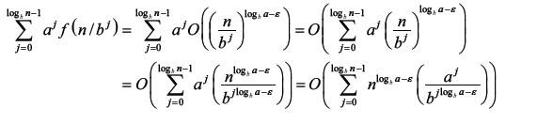
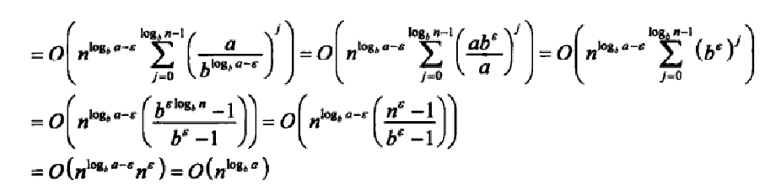
f (n)<(n^{log}bª)

Slide 148
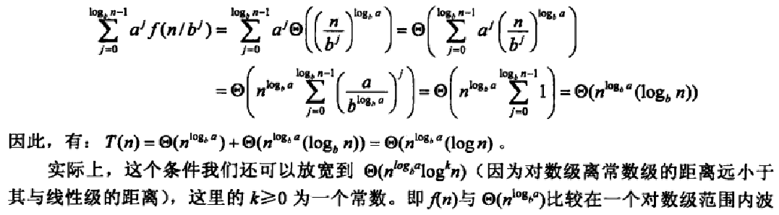
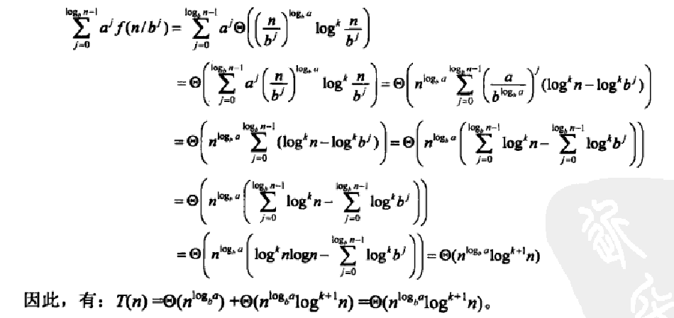
f (n)=(n^{log}bª)

Slide 149
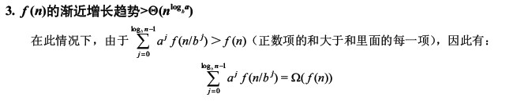
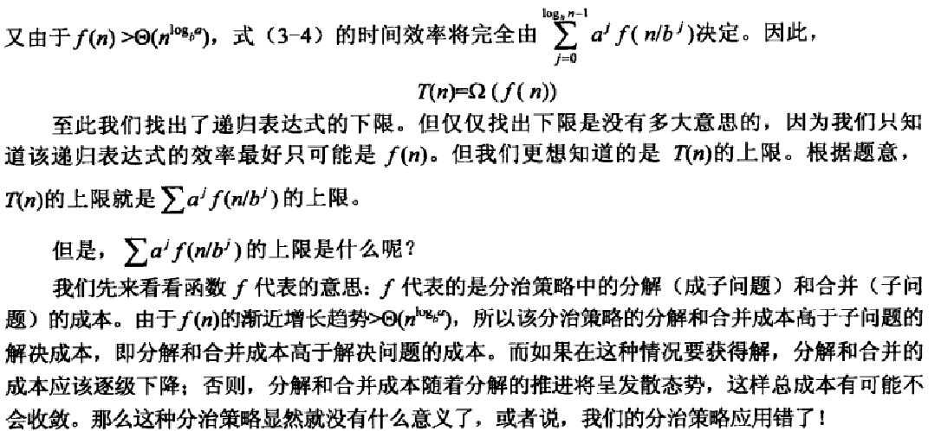
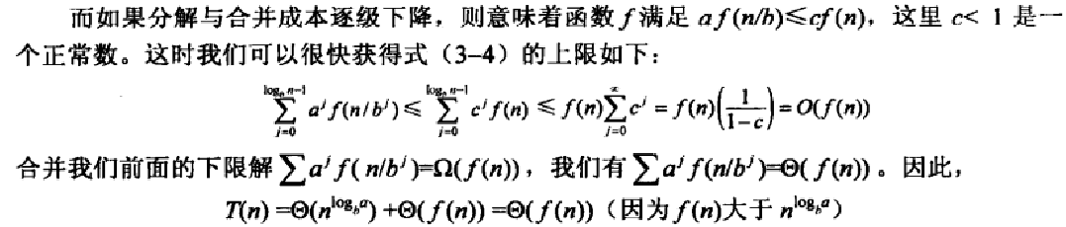
f (n)>(n^{log}bª)

Slide 150
Summary: “Cookbook” for solving recurrences

Slide 151
❒
✓

Slide 152
Examples (cont.)
T(n) = 2T(n/2) +
a = 2, b = 2, log₂2 = 1
Compare n with f(n) = n^{1/2}
⇒ f(n) = O(n^{1-ε}) Case 1
⇒ T(n) = Θ(n)

Slide 153
Examples
T(n) = 2T(n/2) + n
a = 2, b = 2, log₂2 = 1
Compare n^{log}₂² with f(n) = n
⇒ f(n) = Θ(n) ⇒ Case 2
⇒ T(n) = Θ(nlgn)

Slide 154
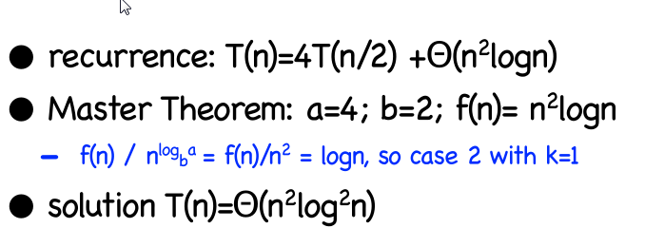
Examples (cont.)

Slide 155
Examples
T(n) = 2T(n/2) + n²
a = 2, b = 2, log₂2 = 1
Compare n with f(n) = n²
⇒ f(n) = Ω(n^{1+ε}) Case 3 ⇒ verify regularity cond.
a f(n/b) ≤ c f(n)
⇔ 2 n²/4 ≤ c n² ⇒ c = ½ is a solution (c<1)
⇒ T(n) = Θ(n²)

Slide 156
Examples
T(n) = 3T(n/4) + nlgn
a = 3, b = 4, log₄3 = 0.793
Compare n^{0.793} with f(n) = nlgn
f(n) = Ω(n^{log}₄^{3+ε}) Case 3
Check regularity condition:
3∗(n/4)lg(n/4) ≤ (3/4)nlgn = c ∗f(n), c=3/4
⇒T(n) = Θ(nlgn)

Slide 157
Examples
T(n) = 2T(n/2) + nlgn
a = 2, b = 2, log₂2 = 1
Compare n with f(n) = nlgn
  seems like case 3 should apply
f(n) must be polynomially larger by a factor of n^{ε}
In this case it is only larger by a factor of lgn

Slide 158
Master Theorem: simpler case
Let T(n) be a monotonically increasing function that satisfies
T(n) = a T(n/b) + f(n)
T(1) = c
where a ≥ 1, b ≥ 2, c>0. If f(n) is Θ(n^{d}) where d ≥ 0 then
 |  | if a < b^{d}
T(n) = |  | If a = b^{d}
 |  | if a > b^{d}

Slide 159
Master Theorem: Example 1
Let T(n) = T(n/2) + ½ n² + n. What are the parameters?
a =
b =
d =
Therefore, which condition applies?
1
2
2
1 < 2², case 1 applies
We conclude that
T(n) ∈ Θ(n^{d}) = Θ (n²)

Slide 160
Master Theorem: Example 2
Let T(n)= 2 T(n/4) + √n + 42. What are the parameters?
a =
b =
d =
Therefore, which condition applies?
2
4
1/2
2 = 4^{1/2}, case 2 applies
We conclude that

Slide 161
Master Theorem: Example 3
Let T(n)= 3 T(n/2) + 3/4n + 1. What are the parameters?
a =
b =
d =
Therefore, which condition applies?
3
2
1
3 > 2¹, case 3 applies
We conclude that
Note that log₂3≈1.584…, can we say that T(n) ∈ Θ (n^{1.584})
No, because log₂3≈1.5849… and n^{1.584} ∉ Θ (n^{1.5849})

Slide 162
Master Theorem: Pitfalls
You cannot use the Master Theorem if
  T(n) is not monotone, e.g. T(n) = sin(x)
  f(n) is not a polynomial, e.g., T(n)=2T(n/2)+2^{n}
  b cannot be expressed as a constant, e.g.
Note that the Master Theorem does not solve the recurrence equation
Does the base case remain a concern?

Slide 163
Outline
Motivation
The Master Theorem
  Pitfalls
  3 examples
4th Condition
  1 example

Slide 164
‘Fourth’ Condition
Recall that we cannot use the Master Theorem if f(n), the non-recursive cost, is not a polynomial
There is a limited 4th condition of the Master Theorem that allows us to consider polylogarithmic functions
Corollary: If for some k≥0 then
This final condition is fairly limited and we present it merely for sake of completeness.. Relax ☺

Slide 165
‘Fourth’ Condition: Example
Say we have the following recurrence relation
T(n)= 2 T(n/2) + n log n
Clearly, a=2, b=2, but f(n) is not a polynomial. However, we have f(n)∈Θ(n log n), k=1
Therefore by the 4th condition of the Master Theorem we can say that

Slide 166
Applications of Recursion
Another Numerical Computation Example

Slide 167
The Greatest Common Divisor (GCD) Problem
Given two integers, what is their greatest common divisor?
e.g., gcd(56,24) =

Slide 168
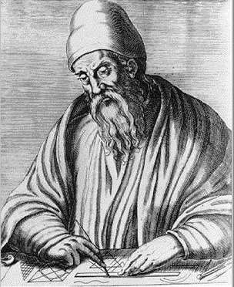
Euclid’s Trick
Euclid of Alexandria,
"The Father of Geometry"
c. 300 BC
Good!
Better!
Too Far!

Slide 169
Euclid’s Algorithm (circa 300 BC)

Slide 170
Time Complexity
✓
✓

Slide 171
Time Complexity

Slide 172
Applications of Recursion
Data Organization

Slide 173
A Simple Example:
The Tower of Hanoi

Slide 174
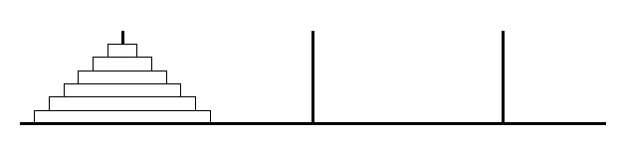
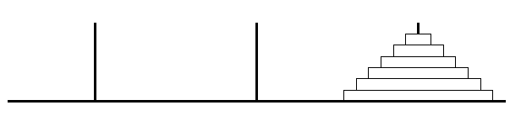
Tower of Hanoi
This job of mine is a bit daunting.
Where do I start?
And I am lazy.

Slide 175
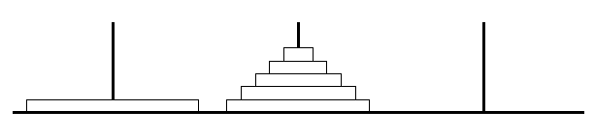
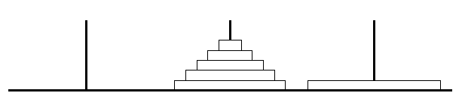
Tower of Hanoi
At some point,
the biggest disk moves.
I will do that job.

Slide 176
Tower of Hanoi
To do this,
the other disks must be in the middle.

Slide 177
Tower of Hanoi
How will these move?
I will get a friend to do it.
And another to move these.
I only move the big disk.

Slide 178
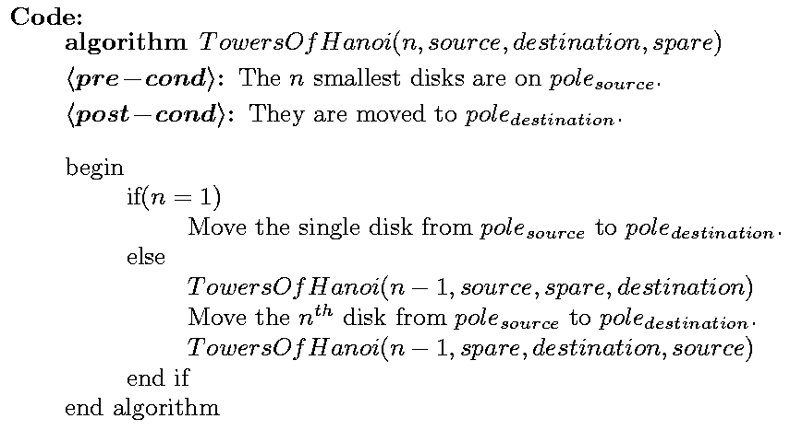
Tower of Hanoi

Slide 179
Tower of Hanoi
Time:
T(1) = 1,
T(n) =
≈ 2(2T(n-2))
≈ 4(2T(n-3))
1 + 2T(n-1)
≈ 2T(n-1)
≈ 4T(n-2)
≈ 8T(n-3)
≈ 2^{i} T(n-i)
≈ 2^{n}

Slide 180
More Data Organization Examples
Sorting

Slide 181
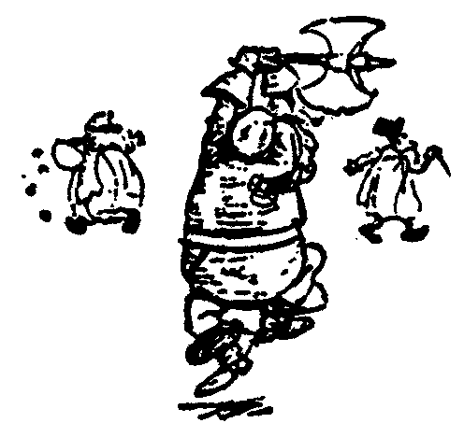
Recursive Sorts
Given list of objects to be sorted
Split the list into two sublists.
Recursively have a friend sort the two sublists.
Combine the two sorted sublists into one entirely sorted list.

Slide 182
Example: Merge Sort

Slide 183
Merge Sort
88
52
14
31
98
25
30
62
23
79
Divide and Conquer

Slide 184
Merge Sort
88
52
Split Set into Two
14
31
98
(no real work)
25
30
62
23
79
Get one friend to
sort the first half.
Get one friend to
sort the second half.
25,31,52,88,98
14,23,30,62,79

Slide 185
Merge Sort
Merge two sorted lists into one
25,31,52,88,98
14,23,25,30,31,52,62,79,88,98
14,23,30,62,79

Slide 186
Merge Sort
Time: T(n) =
2T(n/2) + Θ(n)
= Θ(n log(n))

Slide 187
Example: Quick Sort

Slide 188
Quick Sort
88
52
14
31
98
25
30
62
23
79
Divide and Conquer

Slide 189
Quick Sort
Partition set into two using
randomly chosen pivot
88
52
14
31
98
25
30
62
23
79
14
88
98
31
30
≤ 52 ≤
62
25
23
79

Slide 190
Quick Sort
14
88
98
31
30
≤ 52 ≤
62
25
23
79
Get one friend to
sort the first half.
Get one friend to
sort the second half.
14,23,25,30,31
62,79,98,88

Slide 191
Quick Sort
14,23,25,30,31
52
62,79,98,88
Glue pieces together.
(No real work)
14,23,25,30,31,52,62,79,88,98

Slide 192
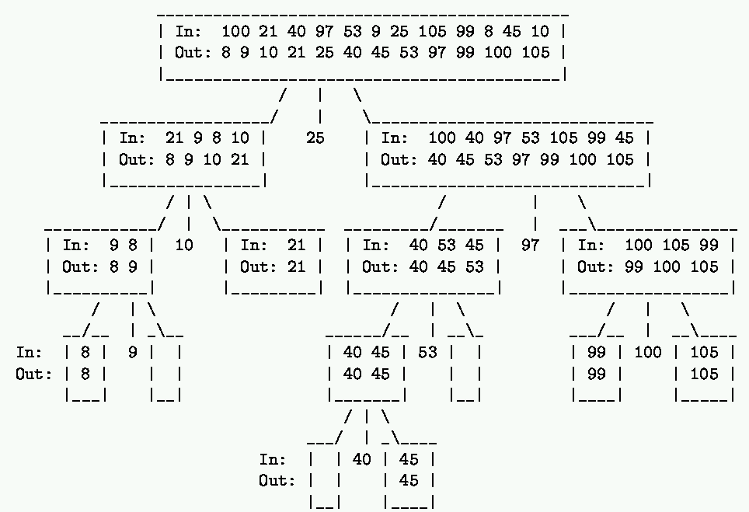

Slide 193
Quick Sort
Let pivot be the first
element in the list?
88
52
14
31
98
25
30
62
23
79
14
88
98
30
≤ 31 ≤
62
25
23
52
79

Slide 194
Quick Sort
14,23,25,30,31,52,62,79,88,98
≤ 14 ≤
23,25,30,31,52,62,79,88,98
If the list is already sorted,
then the list is worst case unbalanced.

Slide 195
Quick Sort
Best Time:
T(n) = 2T(n/2) + Θ(n)
= Θ(n log(n))
Worst Time:
Expected Time:

Slide 196
Quick Sort
Best Time:
T(n) = 2T(n/2) + Θ(n)
= Θ(n log(n))
Worst Time:
T(n) = T(1) + T(n-1) + Θ(n)
= Θ(n²)
Expected Time:

Slide 197
Quick Sort
Best Time:
T(n) = 2T(n/2) + Θ(n)
= Θ(n log(n))
Worst Time:
T(n) = T(0) + T(n-1) + Θ(n)
= Θ(n²)
Expected Time:
T(n) = Θ(nlog(n))
(The proof is not difficult, but it’s a little long)

Slide 198
Expected Time Complexity for Quick Sort

Slide 199
Expected Time Complexity for Quick Sort

Slide 200
Properties of QuickSort
In-place?
Stable?
Fast?
  Depends.
  Worst Case:
  Expected Case:
✓
✓

Slide 201
Heapsort
O(nlogn) worst case – like merge sort
Sorts in place – like insertion sort
Combines the best of both algorithms

Slide 202
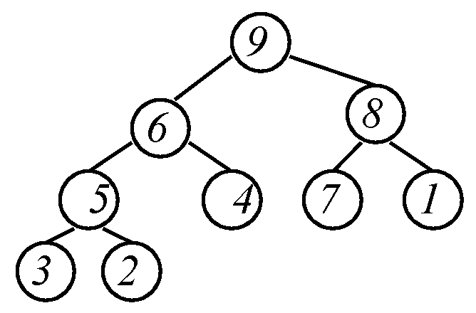
Heap Definition (MaxHeap)
Balanced binary tree
The value of each node ≥ each of the node's children.
Left or right child could be next largest.
Where can 9 go?
Maximum is at root.
Where can 1 go?
Where can 8 go?

Slide 203
Some Additional Properties of Heaps
h =
3
h =
2
h =
1
h =
1
h =
0
h =
0

Slide 204
Some Additional Properties of Heaps
i = 1
i = 3
i = 2
i = 4
i = 5
i = 6
i = 7
i = 8
i = 9

Slide 205
Some Additional Properties of Heaps
i = 1
i = 3
i = 2
i = 4
i = 5
i = 6
i = 7
i = 8
i = 9

Slide 206
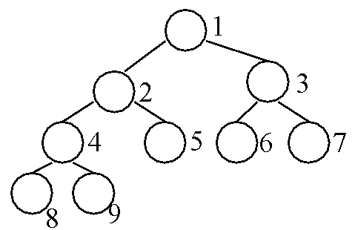

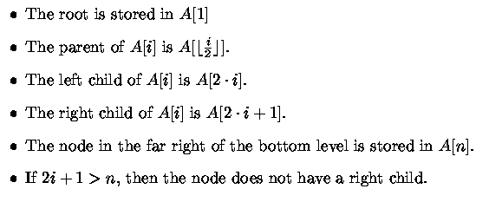
Heap Data Structure
Balanced Binary Tree Implemented by an Array

Slide 207
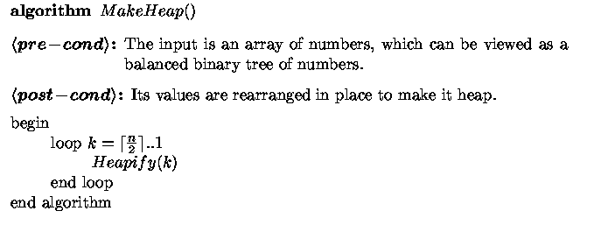
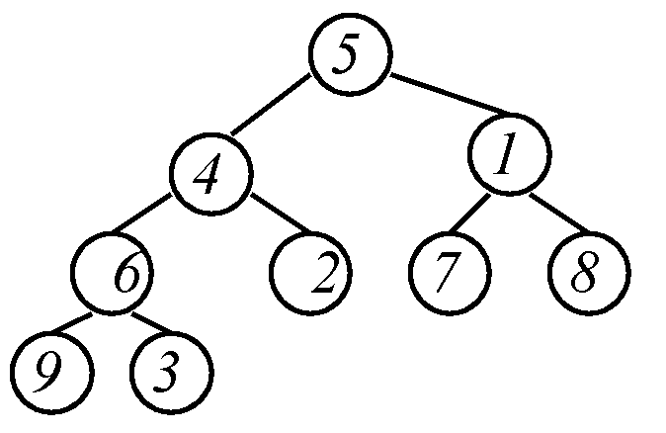
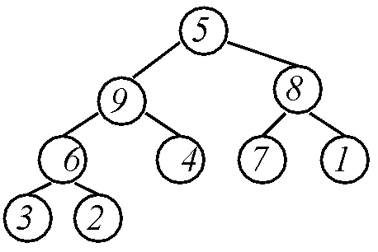
Make Heap
Get help from friends
Now we are just left with this problem

Slide 208
Heapify
Max-Heapify(A, i, n)
<pre-cond>: Left and right subtrees of A[i] are max heaps.
<post-cond>: Subtree rooted at i is a heap.
Where should the maximum be?
Maximum must be at root.
i
?

Slide 209
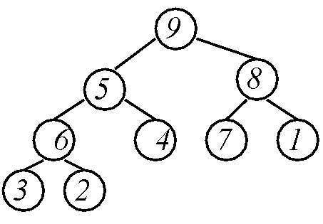
Heapify
Max-Heapify(A, i, n)
<pre-cond>: Left and right subtrees of A[i] are max heaps.
<post-cond>: Subtree rooted at i is a heap.
Find the maximum.
Put it in place
i
?
Repeat

Slide 210

Heapify
Max-Heapify(A, i, n)
<pre-cond>: Left and right subtrees of A[i] are max heaps.
<post-cond>: Subtree rooted at i is a heap.
Heap
Running Time:

Slide 211
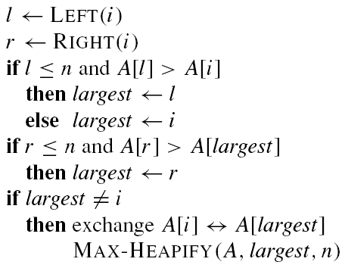
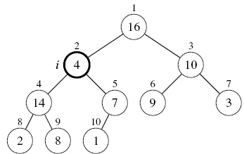
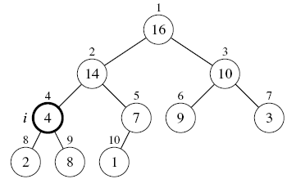
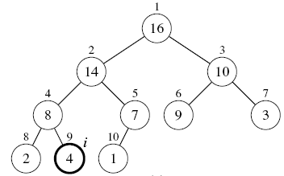
Max-Heapify(A, i, n)
<pre-cond>: Left and right subtrees of A[i] are max heaps.
<post-cond>: Subtree rooted at i is a heap.
e.g., Max-Heapify (A,2,10)
    Max-Heapify (A,4,10)
      Max-Heapify (A,9,10)

Slide 212
MakeHeap
MakeHeap uses Max-Heapify to reorganize the tree from bottom to top to make it a heap.
MakeHeap can be written concisely in either recursive or iterative form.

Slide 213
Recursive MakeHeap
Invoke as MakeHeap (A, 1, n)
Running time:
T(n) = 2T(n/2) + log(n)
= Θ(n)
i
n

Slide 214
Recursive MakeHeap
Question from last class: what if i = 4??
What then is n??
i
n

Slide 215
Recursive MakeHeap
i = 1
i = 2
i = 3
i = 4
i = 5
i = 6
i = 7
n = ?

Slide 216

Iterative MakeHeap
?
Heaps
Heap
Max-Heapify(A, i, n)
<pre-cond>: Left and right subtrees of A[i] are max heaps.
<post-cond>: Subtree rooted at i is a heap.

Slide 217
Iterative MakeHeap
?
Heap
Max-Heapify(A, i, n)
<pre-cond>: Left and right subtrees of A[i] are max heaps.
<post-cond>: Subtree rooted at i is a heap.

Slide 218
Iterative MakeHeap
?
Heap
Max-Heapify(A, i, n)
<pre-cond>: Left and right subtrees of A[i] are max heaps.
<post-cond>: Subtree rooted at i is a heap.

Slide 219
Iterative MakeHeap
?
Max-Heapify(A, i, n)
<pre-cond>: Left and right subtrees of A[i] are max heaps.
<post-cond>: Subtree rooted at i is a heap.

Slide 220
Iterative MakeHeap
Heap
Max-Heapify(A, i, n)
<pre-cond>: Left and right subtrees of A[i] are max heaps.
<post-cond>: Subtree rooted at i is a heap.

Slide 221
Iterative MakeHeap

Slide 222
Iterative MakeHeap
Recursive and Iterative MakeHeap do essentially the same thing: Heapify from bottom to top.
Difference:
  Recursive is “depth-first”
  Iterative is “breadth-first”

Slide 223
Using Heaps for Sorting

Slide 224
Selection Sort
Largest i values are sorted on the right.
Remaining values are off to the left.
3
5
<
1
6,7,8,9
4
2
Max is easier to find if a heap.

Slide 225
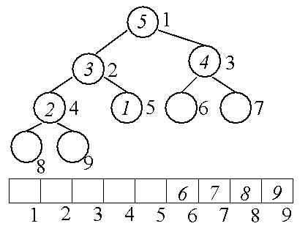
Heap Sort
Largest i values are sorted on side.
Remaining values are in a heap.
4
3
1
2

Slide 226
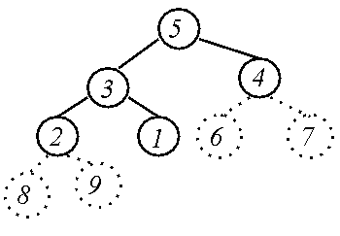
Heap Data Structure
Heap
4
3
4
3
1
2
6
7
1
2
Array
8
9
5
4
3
1
2
Heap
Array

Slide 227
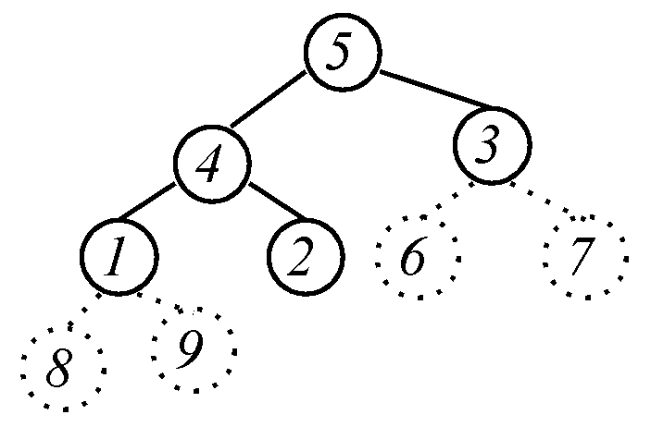
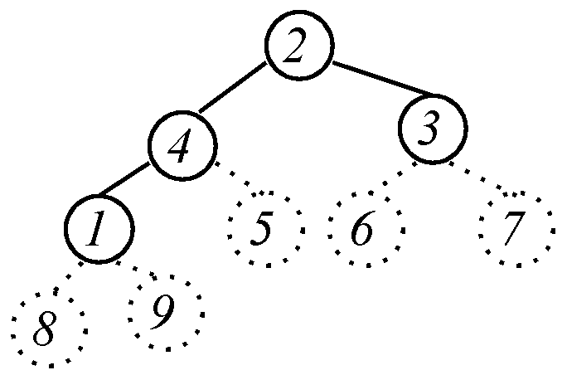

Heap Sort
Largest i values
are sorted on side.
Remaining values are
in a heap
?
Put next value
where it belongs.
Max-Heapify(A, i, n)
<pre-cond>: Left and right subtrees of A[i] are max heaps.
<post-cond>: Subtree rooted at i is a heap.
Heap

Slide 228
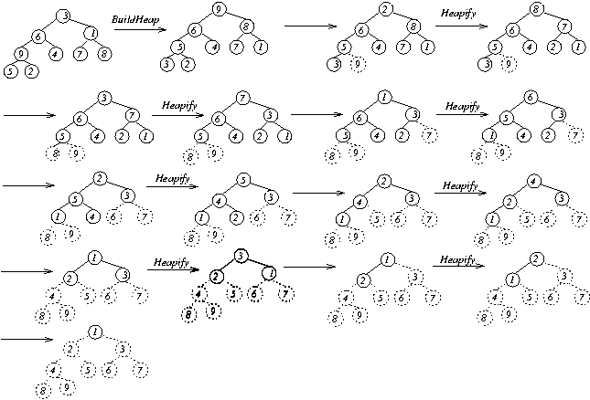
Heap Sort
?
?
?
?
?
?
?
Sorted

Slide 229


Heap Sort
Running Time:

Slide 230
Other Applications of Heaps

Slide 231
Priority Queue
Maintains dynamic set, A, of n elements, each with a key.
Max-priority queue supports:
MAXIMUM(A)
EXTRACT-MAX(A, n)
INCREASE-KEY(A, i, key)
INSERT(A, key, n)
Example Application: Schedule jobs on a shared computer.

Slide 232

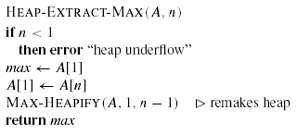

Priority Queues cont’d...
MAXIMUM(A):
EXTRACT-MAX(A,n):

Slide 233
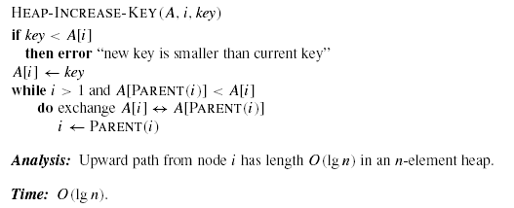


Priority Queue cont’d...
INCREASE-KEY(A, i, key):
INSERT(A, key, n):

Slide 234
Binary Search Trees
Support many dynamic-set operations
Basic operations take time proportional to height h of tree.

Slide 235
Binary Search Tree
Left children ≤ Node ≤ Right children
38
≤
25
≤
51
17
31
42
63
4
21
28
35
40
49
55
71

Slide 236
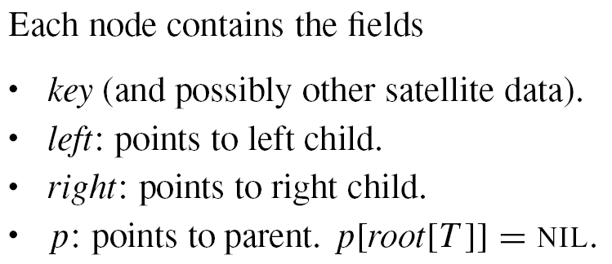
BST Data Structure

Slide 237
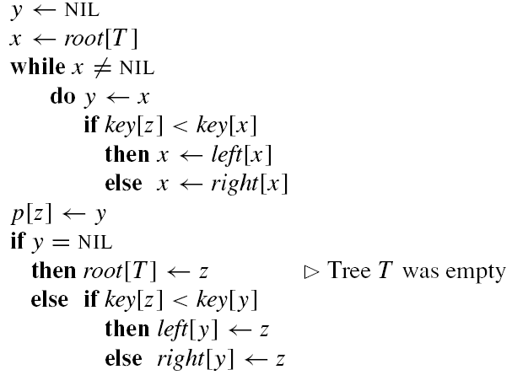
Insertion

Slide 238
Insertion
38
?
25
51
17
31
42
63
4
21
28
35
40
49
55
71
36

Slide 239
Building a Tree

Slide 240
Searching the Tree
PreConditions
  Key 25
  A binary search tree.
PostConditions
  Find key in BST (if there).
38
25
51
17
31
42
63
4
21
28
35
40
49
55
71

Slide 241

Searching the Tree
Maintain a sub-tree.
If the key is contained in the original tree, then the key is contained in the sub-tree.
38
key 17
25
51
17
31
42
63
4
21
28
35
40
49
55
71

Slide 242
Define Step
Cut sub-tree in half.
Determine which half the key would be in.
Keep that half.
38
key 17
25
51
17
31
42
63
4
21
28
35
40
49
55
71
If key < root,
then key is
in left half.
If key = root,
then key is
found
If key > root,
then key is
in right half.

Slide 243
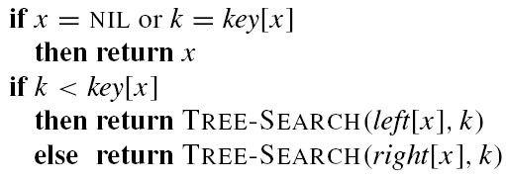
Searching the Tree

Slide 244
Why use (balanced) binary search trees?
What is the advantage over a sorted linear array?
  Search time is the same
  However, maintaining (inserting, deleting, modifying) is
    Θ(logn) for balanced BSTs
    Θ(n) for arrays

